Slide 1
Chemistry Basics of PFAS CMPCoalition Biweekly
June 4, 2025
Alex Stanton, Ph.D.

Slide 2
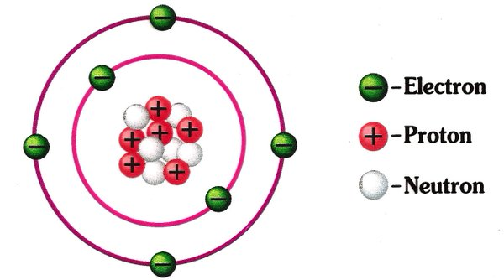
Atoms
Atoms are the basic units of elements – the “smallest constituent of matter which has the properties of a chemical element”
Atoms are comprised of protons, electrons and neutrons
Protons are positively charged subatomic particles
Electrons are negatively charged subatomic particles
Neutrons are subatomic particles without charge
Notes:
https://chem.libretexts.org/Core/Physical_and_Theoretical_Chemistry/Atomic_Theory/The_Atom/Sub-Atomic_Particles
https://www.nde-ed.org/EducationResources/HighSchool/Radiography/subatomicparticles.htm

Slide 3
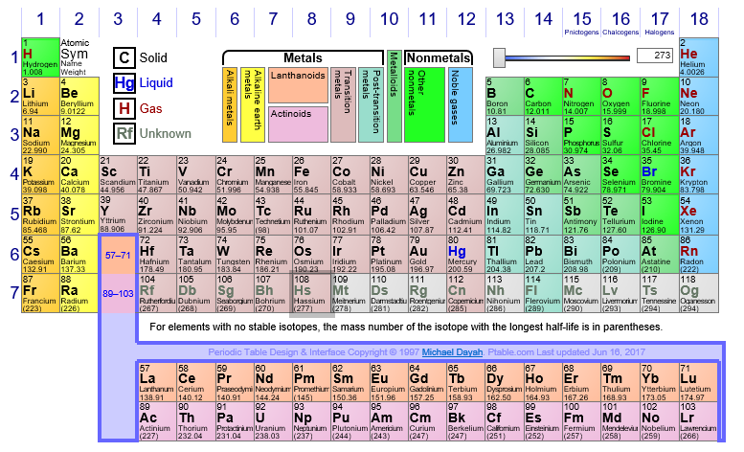
Atomic Number
The number of positively charged protons in an atom dictates the atomic number – every element has a different atomic number
The number of negatively charged electrons in a neutral atom matches the number of protons, and therefore also matches the atomic number
The number of uncharged neutrons, however, can vary
Notes:
https://www.ptable.com/

Slide 4
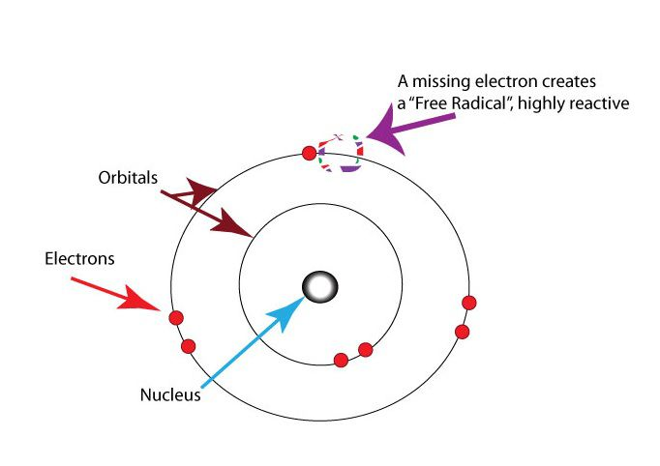
Electrons
Electrons are negatively charged and surround the atomic nucleus
Elements can have a variable number of electrons and still be the same element – only protons determine element identity! Protons never vary within the same element
Electrons have a special property called “spin” – each electron is either spin-up or spin-down
Lowest energetic point when spin-up is paired with spin-down
When an electron is not paired, that electron is a highly reactive free radical
Notes:
http://www.rice.edu/~jenky/sports/antiox.html
https://www.masterorganicchemistry.com/2013/12/09/in-summary-free-radicals/
http://research.cm.utexas.edu/nbauld/unit5_radicals.htm
Graphic from https://www.thoughtco.com/definition-of-free-radical-604468

Slide 5
Losing or Gaining Electrons
When an atom loses an electron, it is a cation, and obtains an overall positive charge
When an atom gains an electron, it is an anion, and obtains an overall negative charge
It is unlikely that an atom will gain or lose more than a few electrons – the charge imbalance would be energetically unfavorable, and all things in the universe trend towards lower energy
Sometimes, instead of electrons being gained or lost by atoms, they are shared between atoms in a covalent bond. A covalent bond is always two electrons being shared between two atoms, but the sharing doesn’t have to be equal!

Slide 6
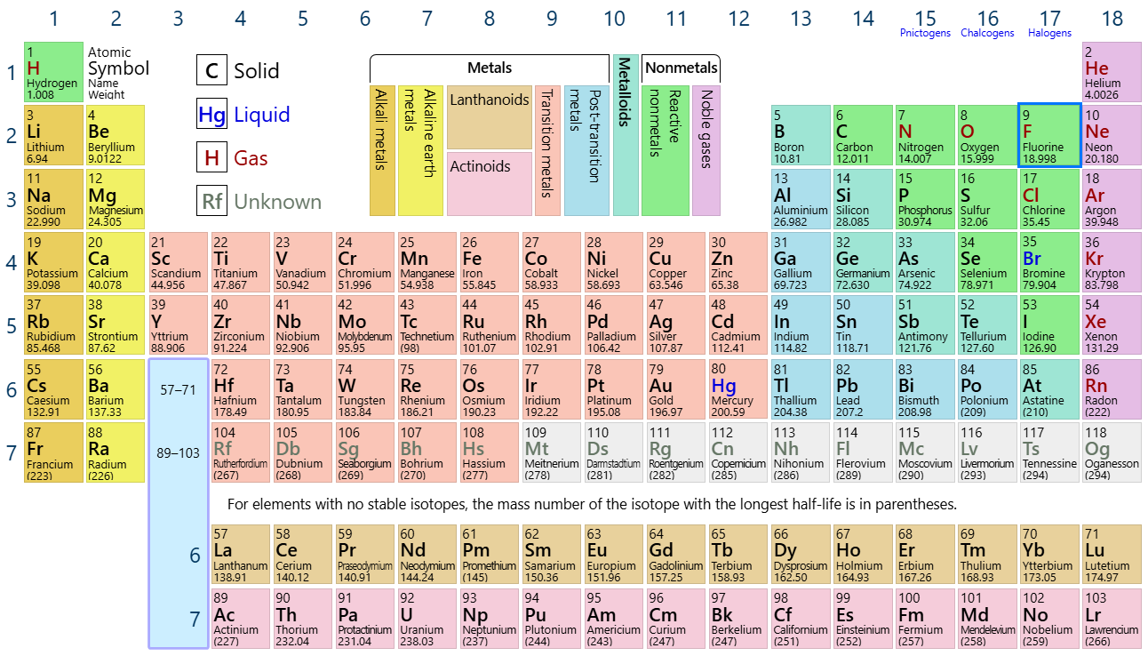
Elemental Fluorine/F
Group 17 – Halogen
The most electronegative or “electron-greedy” element in the entire periodic table
C-F bond extremely strong and stable – ultimate electron sharing atom (C) bonded to the ultimate electron desperate atom (F)

Slide 7
C-F Bonds
In organic chemistry, this is considered the strongest single bond
Because it is so strong, very few events can break the the C-F bond
When the number of F bonded to the same C increases the C-F bond becomes shorter/stronger – so highly fluorinated species are smaller than their non-fluorinated counterparts! This also makes the chemicals less reactive
Fluorinated carbon is chemically and thermally stable, hydrophobic (water resistant), lipophobic (non-polar resistant), an incredibly rare and important characteristic!
Notes:
Integr Environ Assess Manag 2011;7:513–541. © 2011 SETAC Perfluoroalkyl and polyfluoroalkyl substances in the environment: Terminology, classification, and origins
Robert C Buck

Slide 8
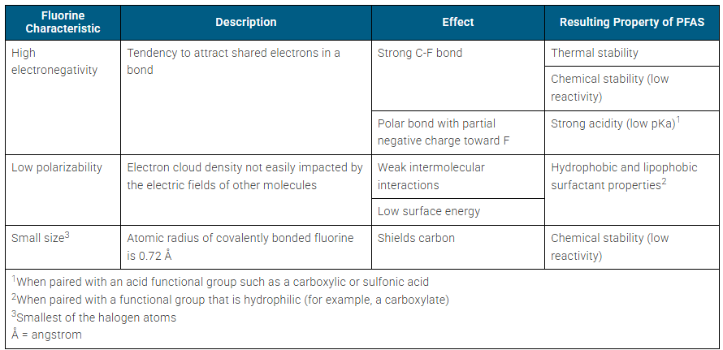
Bonded Fluorine – Valued and Unique Characteristics
Notes:
https://pfas-1.itrcweb.org/4-physical-and-chemical-properties/

Slide 9
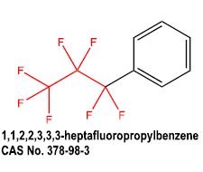
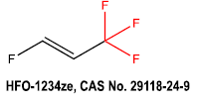
Nomenclature
IUPAC has strict, descriptive naming conventions for specific chemical identities of fluorinated chemical species
These names are very long and highly specific to each individual chemical, so generic names and descriptors are relied upon in literature when discussing groups of fluorinated chemicals
PFAS: per- and polyfluoroalkyl substances
In scientific literature (academic writing), this term encompasses substances in which on one C, all H bonds have been substituted with F (this is “per”) and also substances in which this has happened AND other C-F bonds are present (“poly”)
Per: Fully substituted with F
Poly: Fully substituted with F and there are other C-F bonds
Notes:
Integr Environ Assess Manag 2011;7:513–541. © 2011 SETAC Perfluoroalkyl and polyfluoroalkyl substances in the environment: Terminology, classification, and origins
Robert C Buck

Slide 10
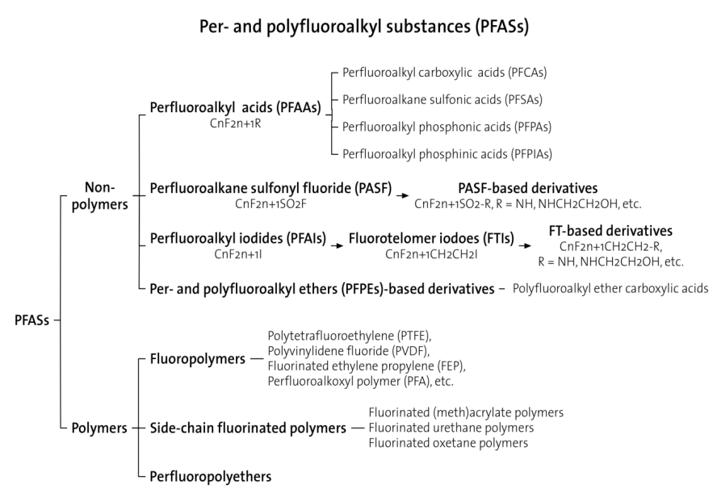
Notes:
Graphic from Integr Environ Assess Manag 2011;7:513–541. © 2011 SETAC Perfluoroalkyl and polyfluoroalkyl substances in the environment: Terminology, classification, and origins
Robert C Buck

Slide 11
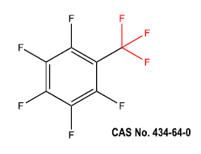
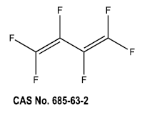
OECD Definition
2021: PFASs are defined as fluorinated substances that contain at least one fully fluorinated methyl or methylene carbon atom (without any H/Cl/Br/I atom attached to it), i.e. with a few noted exceptions, any chemical with at least a perfluorinated methyl group (–CF3) or a perfluorinated methylene group (–CF2–) is a PFAS.
2011 stipulation: “long-chain” refers to:
perfluoroalkyl carboxylic acids (PFCAs) with eight carbons and greater (i.e., with 7 or more perfluorinated carbons) and,
perfluoroalkane sulfonates (PFSAs) with six carbons and greater (i.e., with 6 or more perfluorinated carbons).
The “long-chain” definitions for PFCAs and PFSAs are different in number of C atoms because a PFSA with a given number of carbons (6 in the example given) has a greater tendency to bioconcentrate and/or bioaccumulate than a PFCA with the same number of C atoms
PFAS Not PFAS
Notes:
OECD (2021), Reconciling Terminology of the Universe of Per- and Polyfluoroalkyl Substances: Recommendations and Practical Guidance, OECD Series on Risk Management, No. 61, OECD Publishing, Paris.
Integr Environ Assess Manag 2011;7:513–541. © 2011 SETAC Perfluoroalkyl and polyfluoroalkyl substances in the environment: Terminology, classification, and origins
Robert C Buck

Slide 12
State Definitions: Minnesota and Maine
Minnesota: A class of fluorinated organic chemicals containing at least one fully fluorinated carbon atom
Maine: Any member of the class of fluorinated organic chemicals containing at least one fully fluorinated carbon atom.
Both are similar to the OECD definition
Notes:
https://www.mda.state.mn.us/environment-sustainability/products-added-pfas
https://www.mainelegislature.org/legis/statutes/32/title32sec1732.html

Slide 13
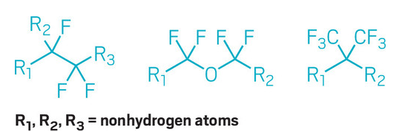
EPA Definitions
For the TSCA 8(a)(7) rule, the definition of “PFAS” includes chemical substances that contain at least one of these three structures: (1) R-(CF2)-CF(R′)R″, where both the CF2 and CF moieties are saturated carbons; (2) R-CF2OCF2-R′, where R and R′ can either be F, O, or saturated carbons; or (3) CF3C(CF3)R′R″, where R′ and R″ can either be F or saturated carbons.
Notes:
https://www.govinfo.gov/content/pkg/FR-2023-10-11/pdf/2023-22094.pdf

Slide 14
Refrigerants
Refrigerants should be able to phase change between liquid and gas at standard temperature and with limited pressure, so the expansion and compression between liquid and gas can have a cooling effect
Original chemicals that met this standard were toxic or flammable gases such as ammonia, sulfur dioxide, methyl chloride, butane, or propane – leaks could be quite hazardous
In 1928, a new non-flammable, non-toxic materials was synthesized, the CFC known as Freon. This was widely used until it became clear that CFCs were having a negative effect on ozone
Thomas Midgley had a legendary understanding of the periodic table
The next generation of refrigerants should have all the advantages of CFCs but not negatively impact the ozone layer – cannot have chlorine, must be highly efficient (higher use worldwide with global warming), and low global warming potential
R-134a (CH2FCF3) gained popularity, as it had similar properties to Freon, but no chlorine. Fluorinated hydrocarbons are well-known to be extremely persistent and bioaccumulative, with varying toxicity. This forced a new dilemma: is it more important for refrigerants to meet carbon neutrality goals, or more important to avoid use of potentially toxic chemicals?
Notes:
https://web.archive.org/web/20180713171048/http://www.r744.com/files/pdf_597.pdf
https://chem.libretexts.org/Bookshelves/Organic_Chemistry/Supplemental_Modules_(Organic_Chemistry)/Fundamentals/Reactive_Intermediates/Free_Radicals#:~:text=In%20chemistry%2C%20a%20radical%20(more,more%20%22dangling%22%20covalent%20bonds.

Slide 15
Flame retardants
Fire: solids are decomposed by heat and release flammable gases, which combust in oxygen and generate gaseous radicals. Those radicals propagate the flame by decomposing more molecules to generate more “fuel,” which burns with the oxygen in the air to produce heat and generate radicals, keeping the reaction going
Under high temperatures, halogenated flame retardants such as those containing bromine (Br), chlorine (Cl), or fluorine (F) release the halogen as free radicals – they have a reactive, unpaired electron. Now on the lookout for extra electrons, these halogenated radicals react with the flammable gases in the fire to produce water and regenerate the halogenated radical, interrupting the combustion cycle.
Recall also that halogens have extremely high heat capacity, particularly the C-F bond, which diminishes heat available for the fire to sustain itself
Notes:
https://aerofiltri.it/DC_pdf/AS_A_HdFRW.pdf
https://flame-retardant.alfa-chemistry.com/halogen-flame-retardant.html#:~:text=Halogen%20flame%20retardants%20(RX)%20work,effectively%20interfere%20with%20their%20oxidation.
https://chem.libretexts.org/Bookshelves/Organic_Chemistry/Supplemental_Modules_(Organic_Chemistry)/Fundamentals/Reactive_Intermediates/Free_Radicals#:~:text=In%20chemistry%2C%20a%20radical%20(more,more%20%22dangling%22%20covalent%20bonds.
https://chem.libretexts.org/Bookshelves/General_Chemistry/Book%3A_Structure_and_Reactivity_in_Organic_Biological_and_Inorganic_Chemistry_(Schaller)/V%3A__Reactivity_in_Organic_Biological_and_Inorganic_Chemistry_3/04%3A_Oxygen_Binding_and_Reduction/4.01%3A_Introduction

Slide 16
Conclusion
Fluorine has particularly unique chemical properties, especially when bonded to carbon
These properties come at a cost – the characteristics that make fluorinated chemicals important and valuable also make them bioaccumulative and persistent
Some uses simply have no known substitute at this time – the properties lent by PFAS are too unique

